Slide 1
Classification and Regression for Time Series Data
ECML PKDD 2024 Tutorial
An Introduction to Machine Learning from Time Series
Matthew Middlehurst
M.B.Middlehurst@soton.ac.uk
School of Electronics and Computer Science (ECS)
University of Southampton (Soton)

Slide 2
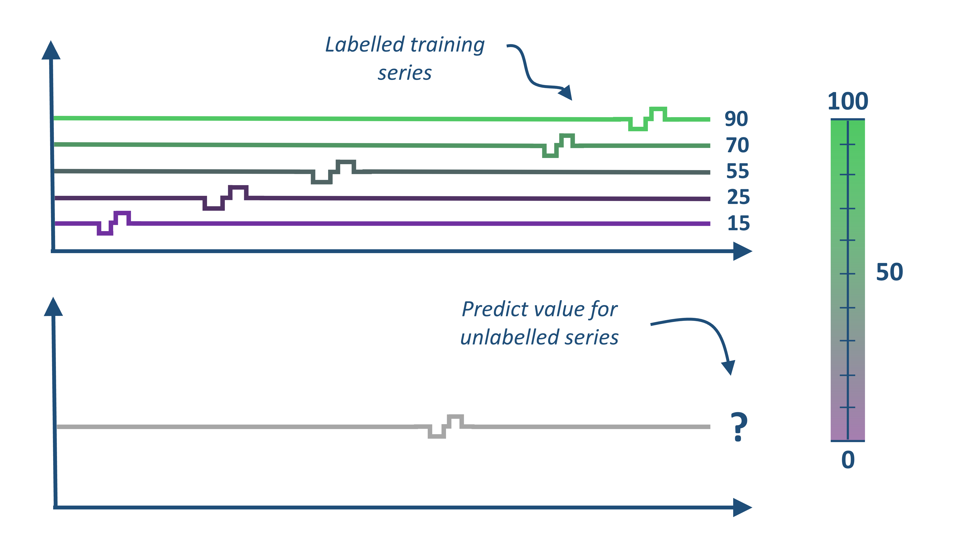
Time Series Classification (TSC) and Regression (TSER)
Our aim is to give you an overview of recent the algorithmic developments and an idea about how/when to uses these algorithms.
We do not cover more specific topics, such as how to deal with unequal length series, missing values or data sampled at different frequencies. Many of the approaches covered can handle multivariate data, but we won’t include these details.
Labelled training series
Classify unlabelled series
?

Slide 3
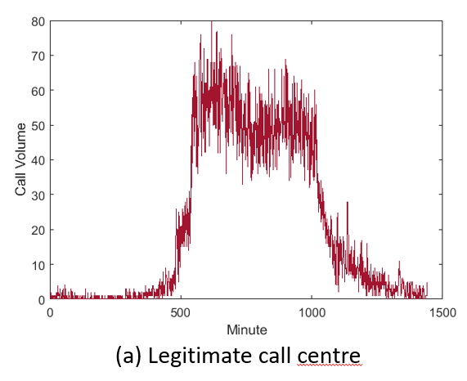
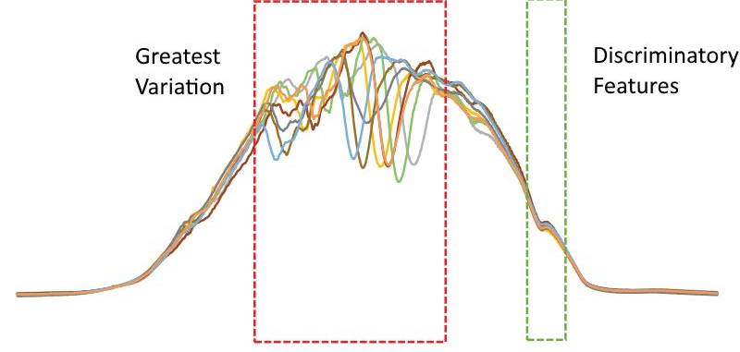
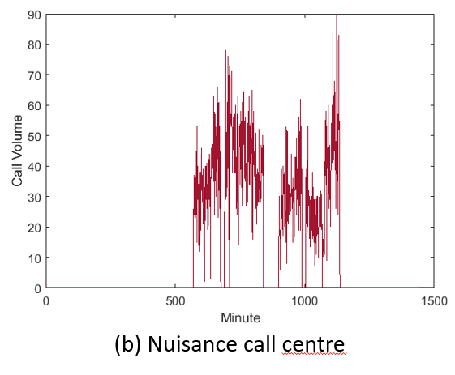
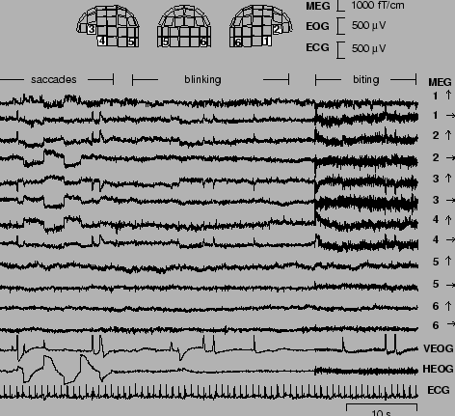
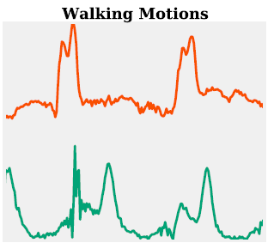
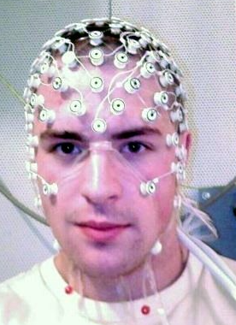
TSC/TSER Applications
Action Records
(Landline Calls)
Food Spectrographs
(Whisky Ethanol)
Human Activity Recognition
(Walking Motions)
Biomedical Signals
(EEG)

Slide 4
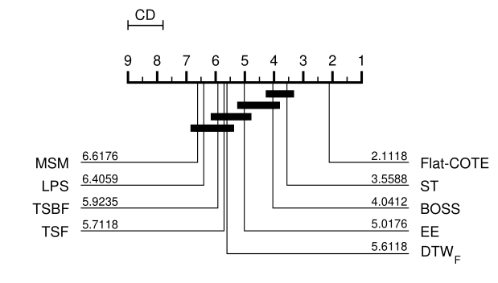
TSC Research in 2016
We start in 2016, at a large-scale comparison of classification algorithms at the time:
Common sentiment at the time and prior: DTW distance with a 1-NN classifier is hard to beat.
The UCR archive: The UCR time series classification archive had recently expanded to 85 datasets
The bakeoff: Comparing 19 algorithms on the new archive, 9 perform significantly better than 1-NN DTW.
Bagnall, A., Lines, J., Bostrom, A., Large, J. and Keogh, E., 2017. The great time series classification bake off: a review and experimental evaluation of recent algorithmic advances. Data mining and knowledge discovery, 31, pp.606-660.

Slide 5

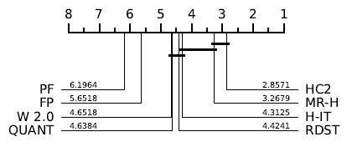

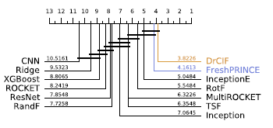


TSC/TSER Research in 2024
A lot of new algorithms have developed in the years since the original bakeoff, prompting a fresh comparison.
UCR Archive expanded to 150+ problems.
Regression archive launched with 60+ datasets.

Slide 6
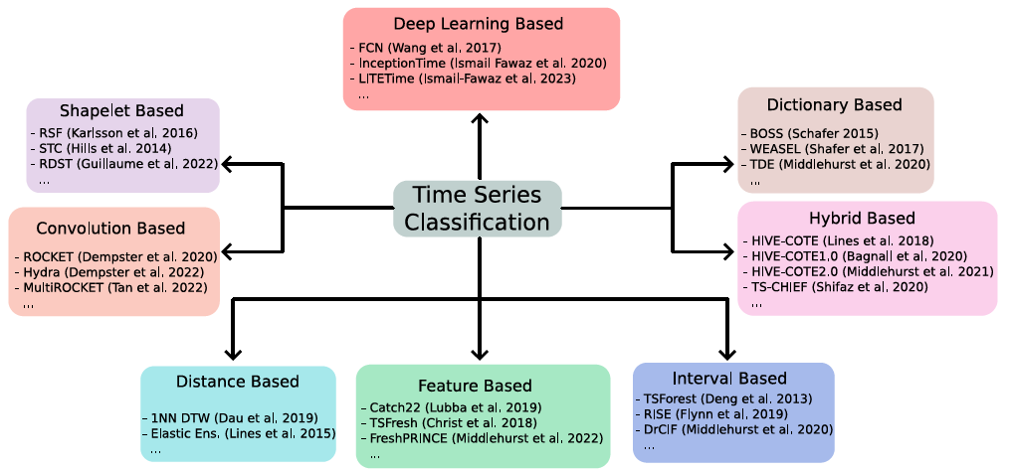
A Taxonomy of Algorithms
TSC/TSER

Slide 7
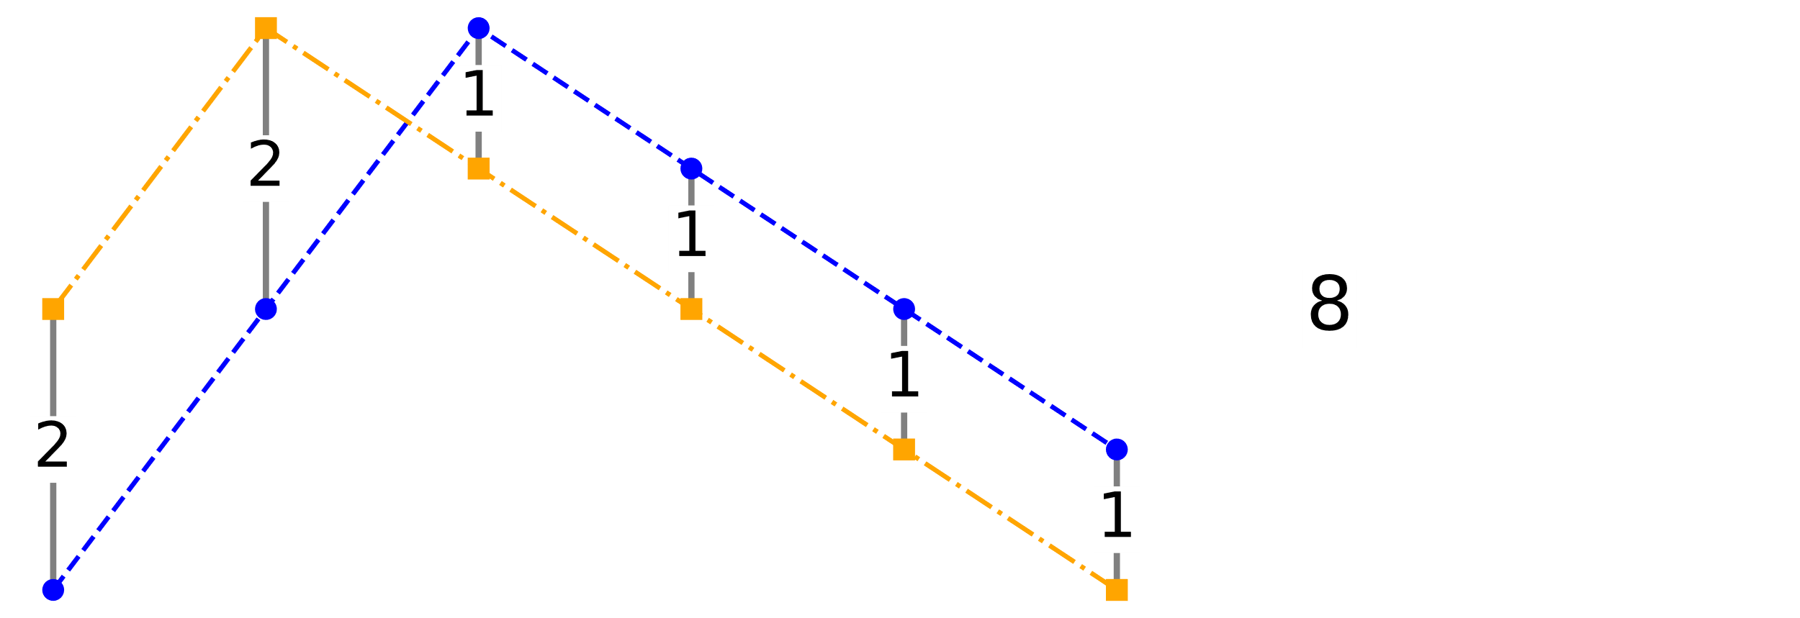
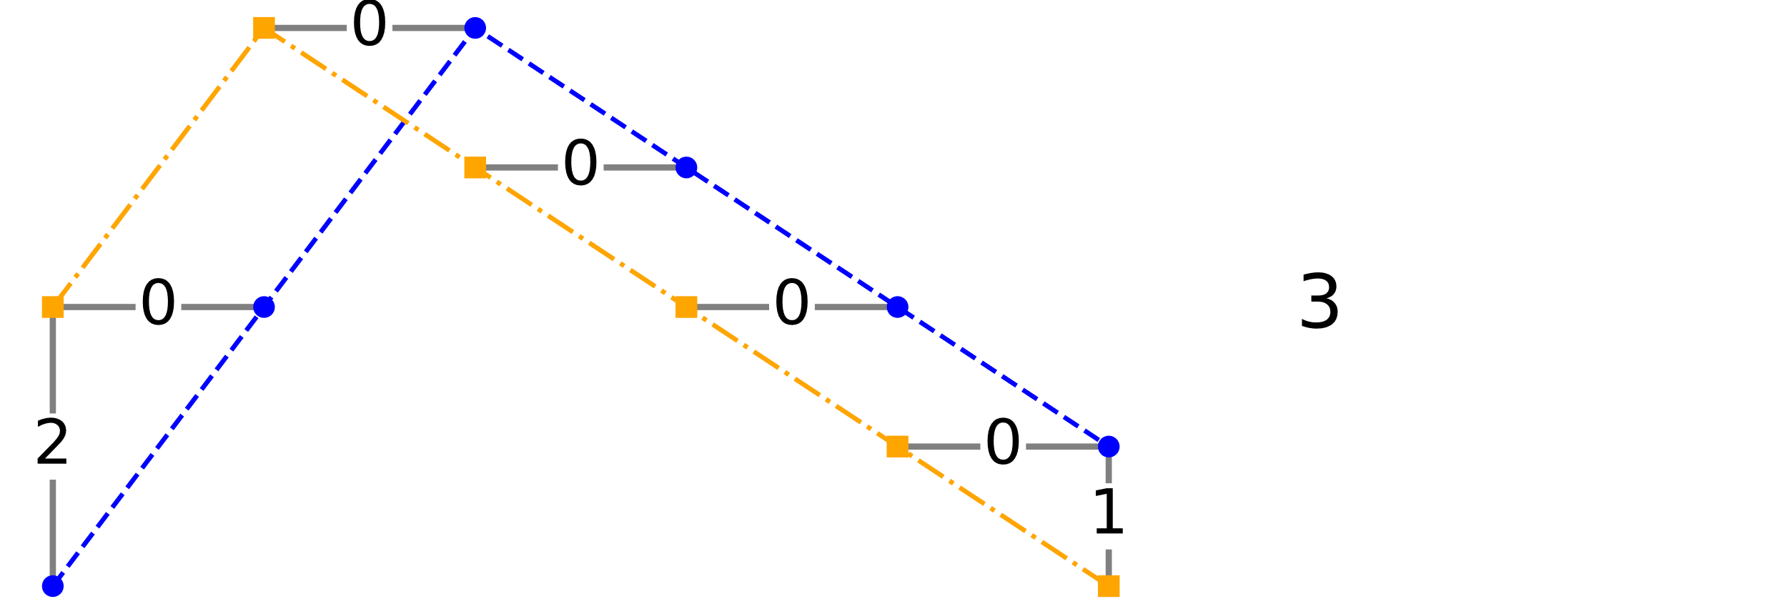
Distance-based Algorithms
Some of the earliest TSC and TSER approaches assessed similarity of series through measures of distance using a nearest neighbour estimator.
Distances are used throughout time series machine learning; we will not cover them in detail here.
Direct distances
(Euclidean distance)
Elastic distances
(Dynamic time warping)

Slide 8
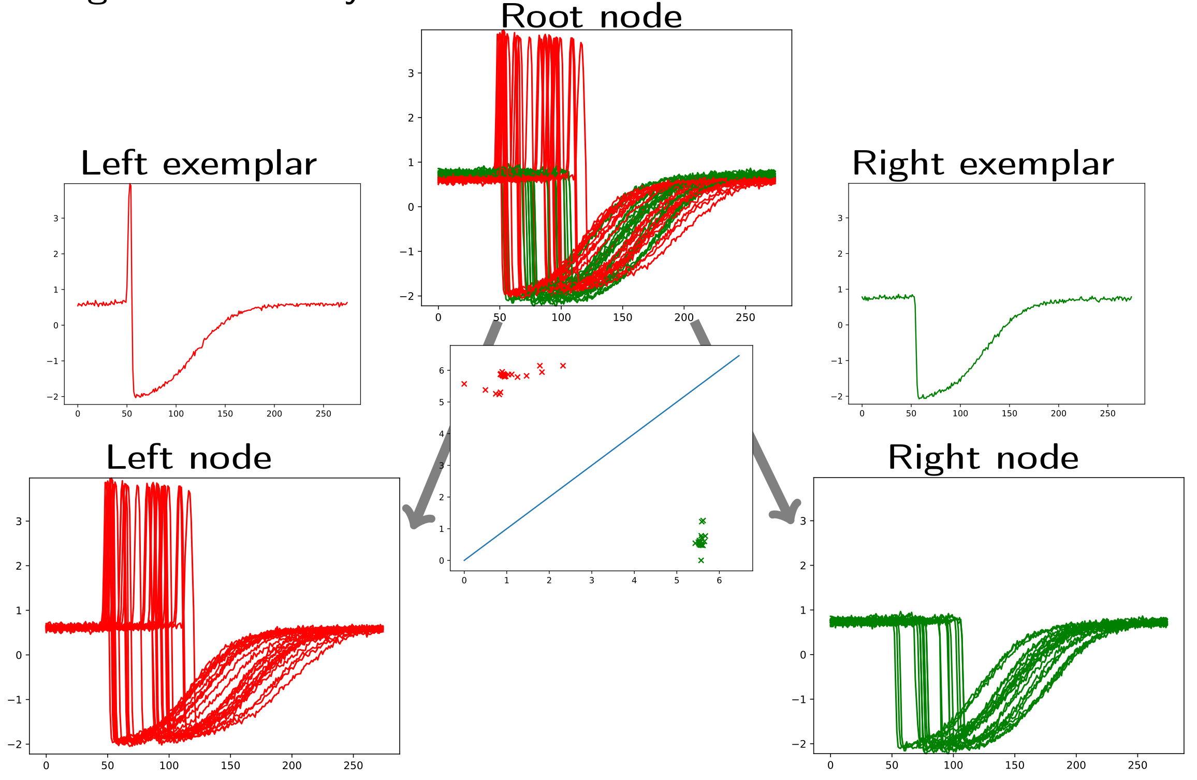
Distance-based Algorithms
The most accurate distance-based approaches usually take the form of ensembles of multiple distances measures.
Two of these ensembles have shown to perform better than 1NN-DTW:
Elastic Ensemble
Proximity Forest
Lines, J. and Bagnall, A., 2015. Time series classification with ensembles of elastic distance measures. Data Mining and Knowledge Discovery, 29, pp.565-592.
Lucas, B., Shifaz, A., Pelletier, C., O’Neill, L., Zaidi, N., Goethals, B., Petitjean, F. and Webb, G.I., 2019. Proximity forest: an effective and scalable distance-based classifier for time series. Data Mining and Knowledge Discovery, 33(3), pp.607-635.

Slide 9
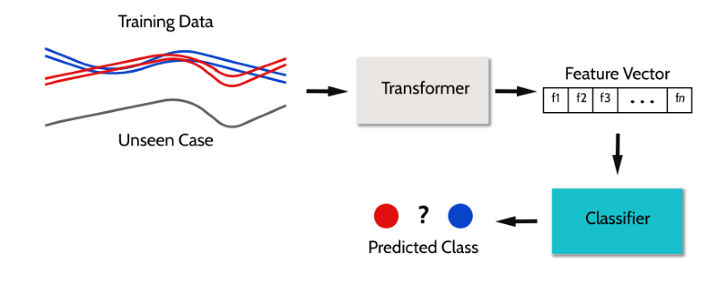
Feature-based Algorithms
One of the easiest approaches is to just summarise the full set of series into a collection of feature vectors
(or numeric value)
(or regressor)

Slide 10
Feature-based Algorithms
Max
10
10
8
8
Max | Min | … | Mean | 25% Q | Class
10 | 3 | … | 5 | 10 | Blue
8 | 2 | … | 4 | 8 | Blue
10 | 2 | … | 5 | 4 | Red
8 | 1 | … | 4 | 2 | Red

Slide 11


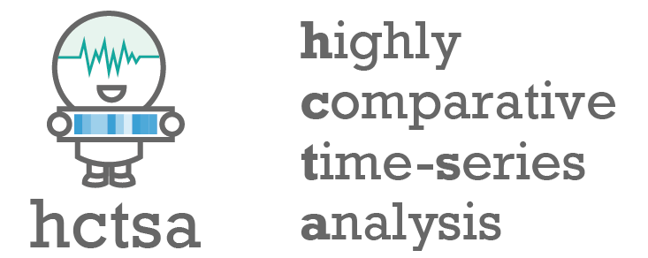

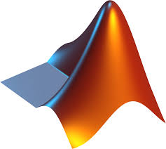
Feature-based Algorithms
There are many feature collections available for time series, we will present 3 more here:
Seven number summary – 7 features, efficient but simple
Catch22 - 22 features, subset of hctsa
TSFresh - ~800 features, includes feature selection
hctsa - ~8000 features, powerful but sluggish
Fulcher, B.D. and Jones, N.S., 2017. hctsa: A computational framework for automated time-series phenotyping using massive feature extraction. Cell systems, 5(5), pp.527-531.
Lubba, C.H., Sethi, S.S., Knaute, P., Schultz, S.R., Fulcher, B.D. and Jones, N.S., 2019. catch22: CAnonical Time-series CHaracteristics: Selected through highly comparative time-series analysis. Data Mining and Knowledge Discovery, 33(6), pp.1821-1852.
Christ, M., Braun, N., Neuffer, J. and Kempa-Liehr, A.W., 2018. Time series feature extraction on basis of scalable hypothesis tests (tsfresh–a python package). Neurocomputing, 307, pp.72-77.

Slide 12
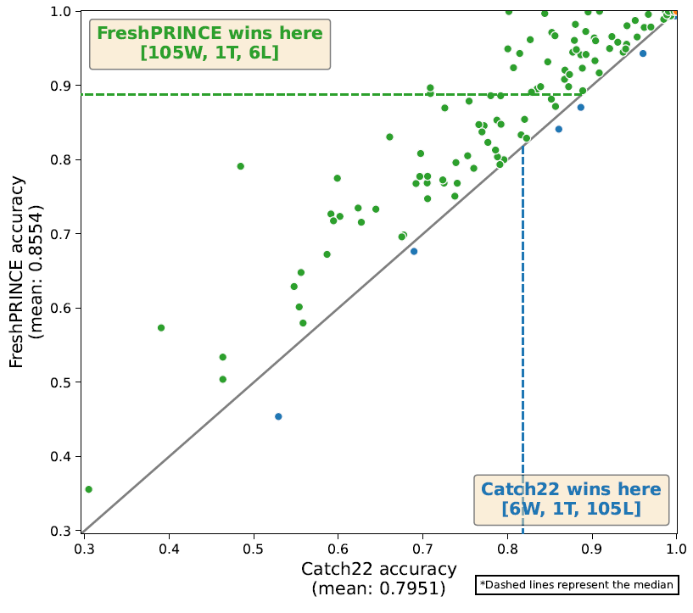
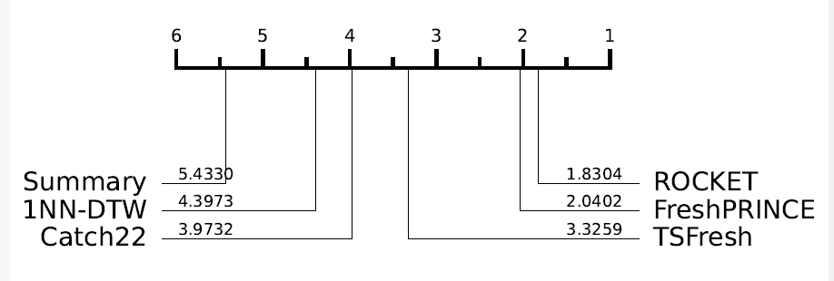
Feature-based Performance
While a lot faster, the smaller feature sets are usually perform worse.
Middlehurst, M. and Bagnall, A., 2022, May. The freshprince: A simple transformation based pipeline time series classifier. In International Conference on Pattern Recognition and Artificial Intelligence (pp. 150-161). Cham: Springer International Publishing

Slide 13
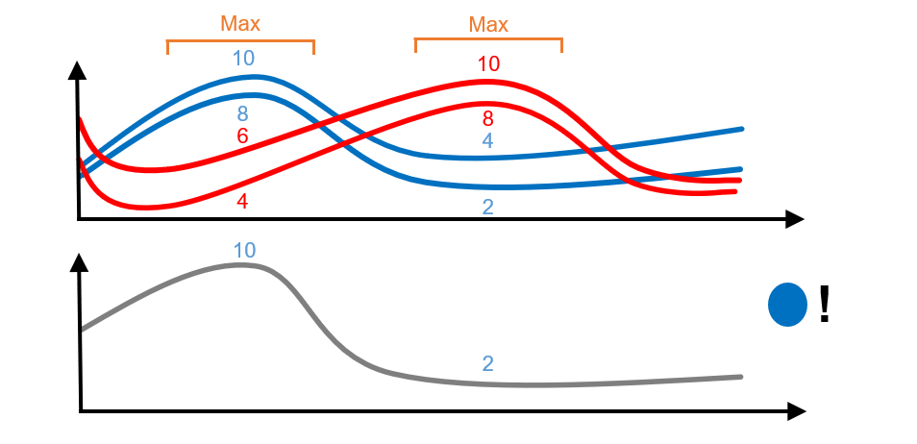
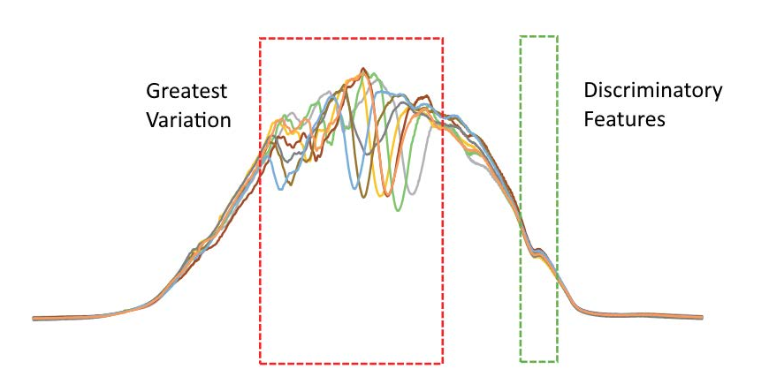
Interval-based Algorithms
Interval based approaches select phase-dependant subseries to extract features from.
These algorithms mostly differ in:
How they choose the subseries to extract features from
The features they extract from each subseries

Slide 14
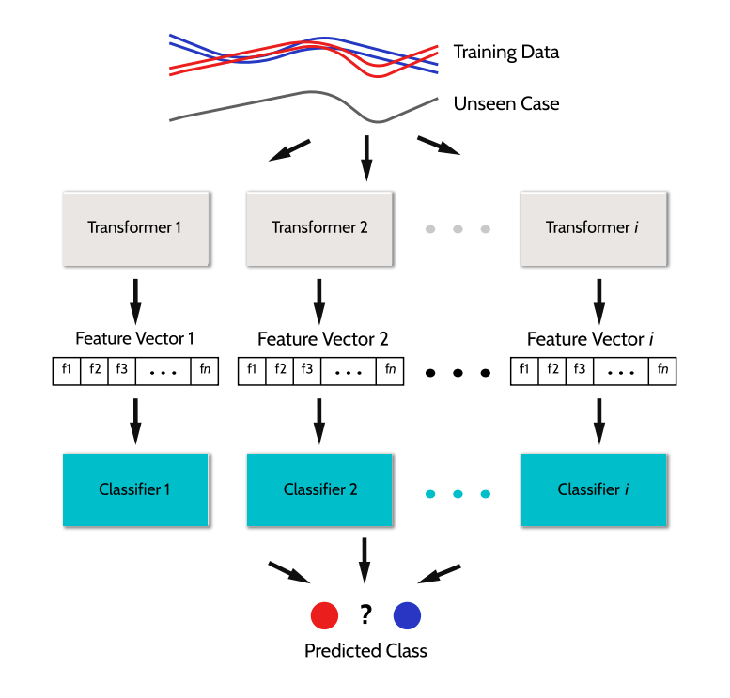
Time Series Forest (TSF)
Key features:
Ensemble of trees
Randomly selects intervals
Extracts 3 simple summary statistics
One of the earliest interval-based approaches
Deng, H., Runger, G., Tuv, E. and Vladimir, M., 2013. A time series forest for classification and feature extraction. Information Sciences, 239, pp.142-153.

Slide 15
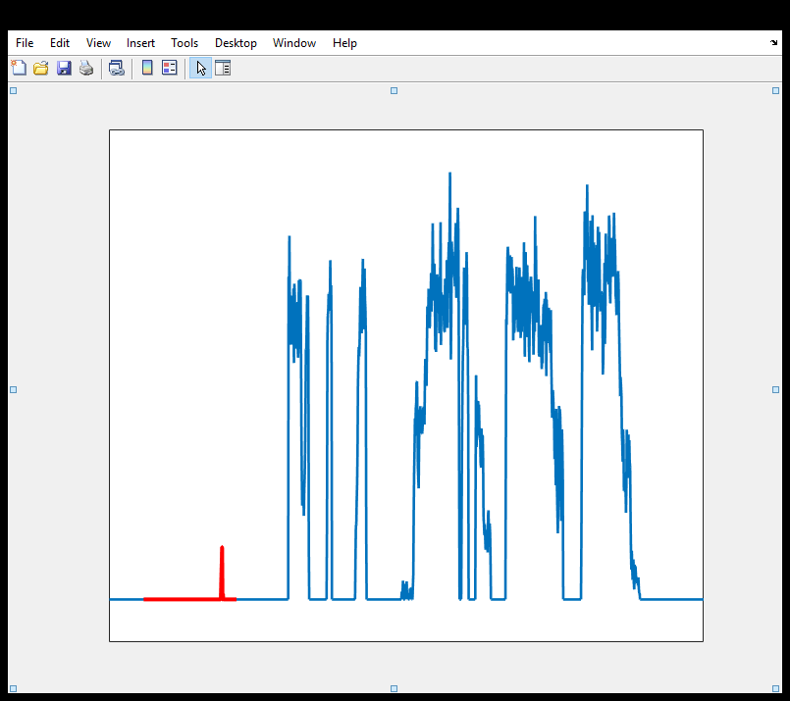
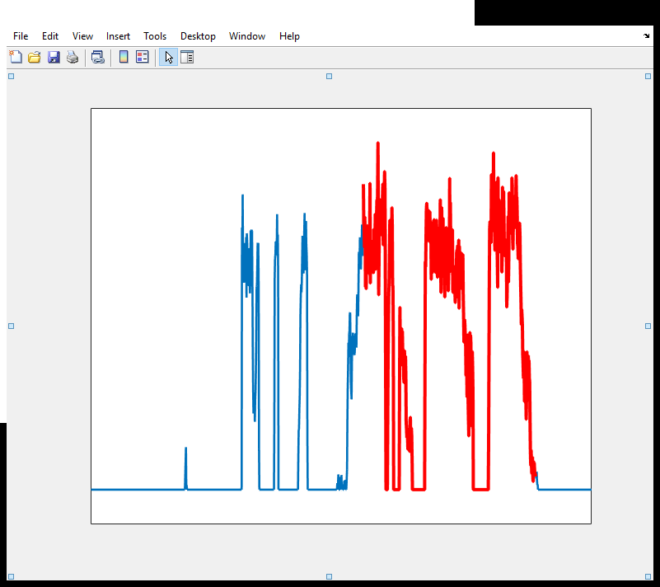
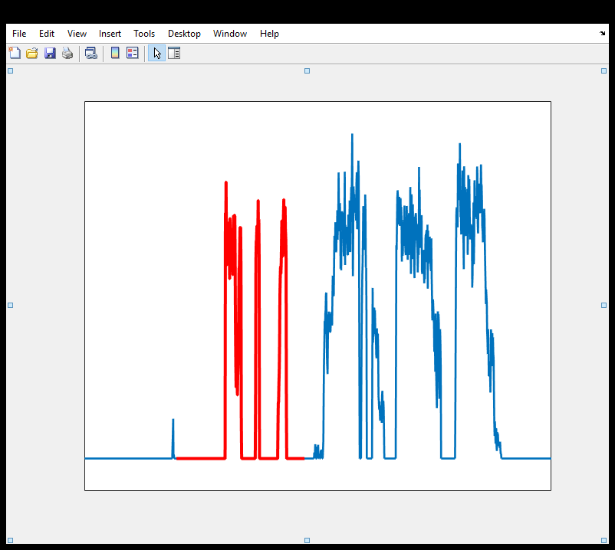
Time Series Forest (TSF)
For each tree
Randomly select multiple intervals
Time Series
Use interval mean, standard deviation and slope as features
Mean 1 | stdev 1 | Slope 1 | Mean 2 | stdev 2 | Slope 2 | Mean 3 | stdev 3 | Slope 3
Extracted Features

Slide 16
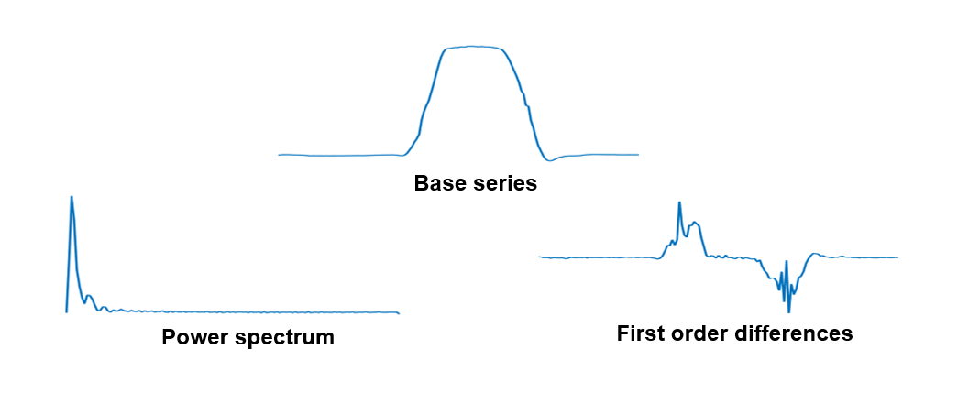
Diverse Representation Canonical Interval Forest (DrCIF)
Key features:
Extracts the Catch22 features as well as 3 simple summary statistics
Subsamples attributes per tree
Creates intervals for a transformed periodogram and first order differences
Middlehurst, M., Large, J., Flynn, M., Lines, J., Bostrom, A. and Bagnall, A., 2021. HIVE-COTE 2.0: a new meta ensemble for time series classification. Machine Learning, 110(11), pp.3211-3243. Middlehurst, M., Large, J. and Bagnall, A., 2020, December. The canonical interval forest (CIF) classifier for time series classification. In 2020 IEEE international conference on big data (big data) (pp. 188-195). IEEE.

Slide 17
Random Supervised Time Series Forest (R-STSF)
Key features:
Extracts intervals using a supervised process (interval/feature combos are evaluated using Fisher score)
Extracts 9 simple summary statistics
Uses a periodogram, first order differences and autoregressive series representation
0.55
0.7
0.9
0.6
0.6
0.8
Cabello, N., Naghizade, E., Qi, J. and Kulik, L., 2024. Fast, accurate and explainable time series classification through randomization. Data Mining and Knowledge Discovery, 38(2), pp.748-811.

Slide 18
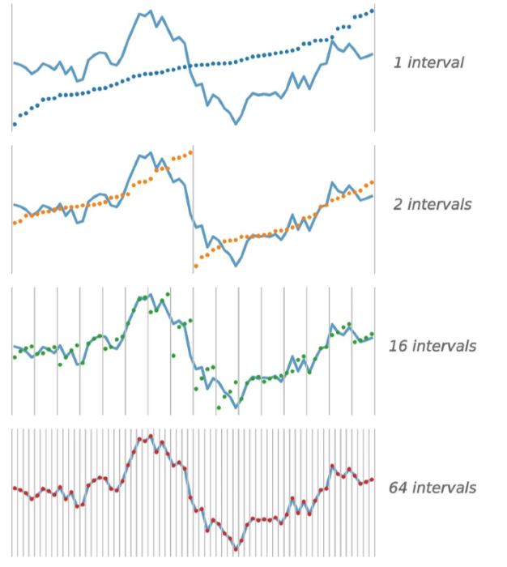
QUANT
Key features:
Extracts fixed dyadic intervals
Uses the quantiles of intervals as features
Extracts from multiple series representations like previous approaches.
Dempster, A., Schmidt, D.F. and Webb, G.I., 2024. Quant: A minimalist interval method for time series classification. Data Mining and Knowledge Discovery, pp.1-26.

Slide 19
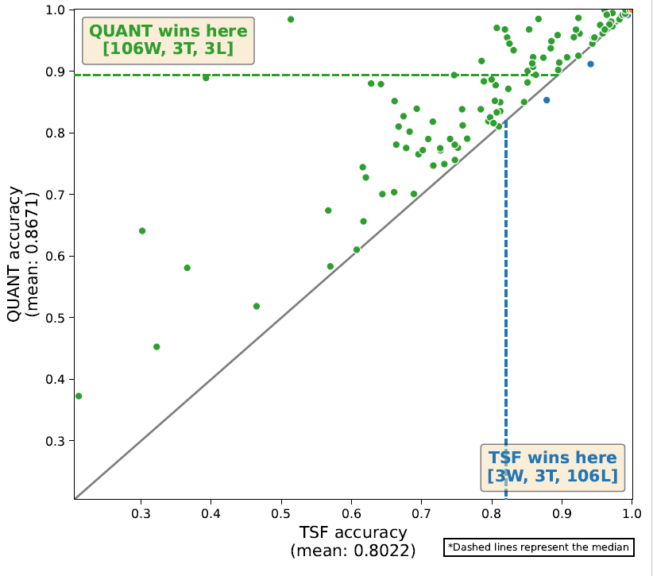
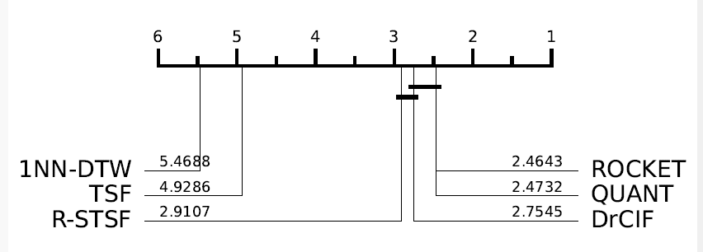
Interval-based Performance
Interval approaches have had a significant amount of improvement over time, with recent approaches eclipsing TSF on benchmark data.

Slide 20
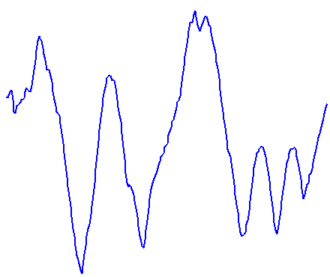

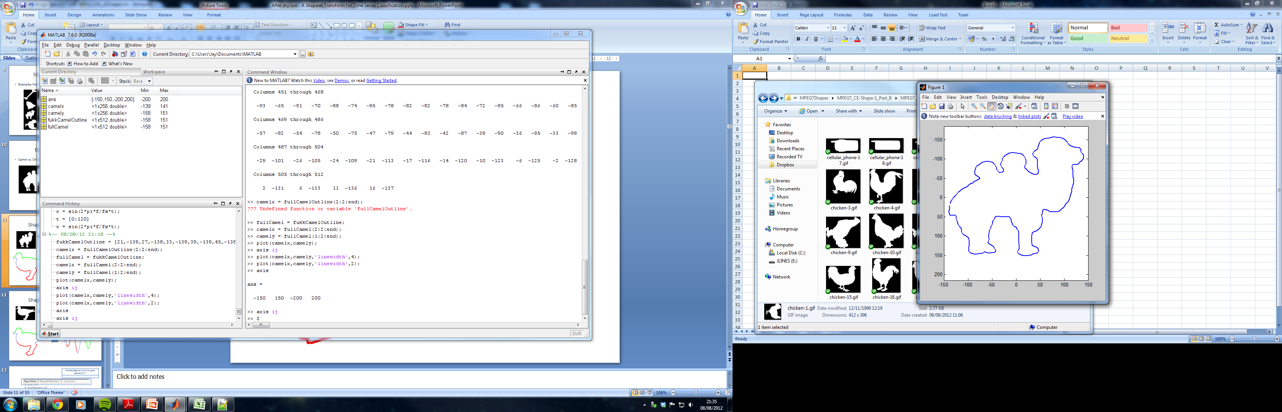
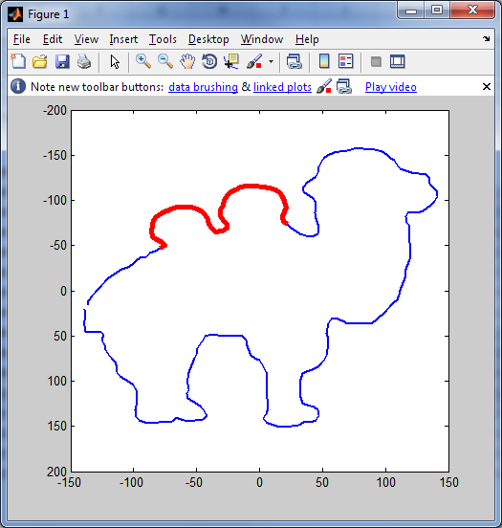
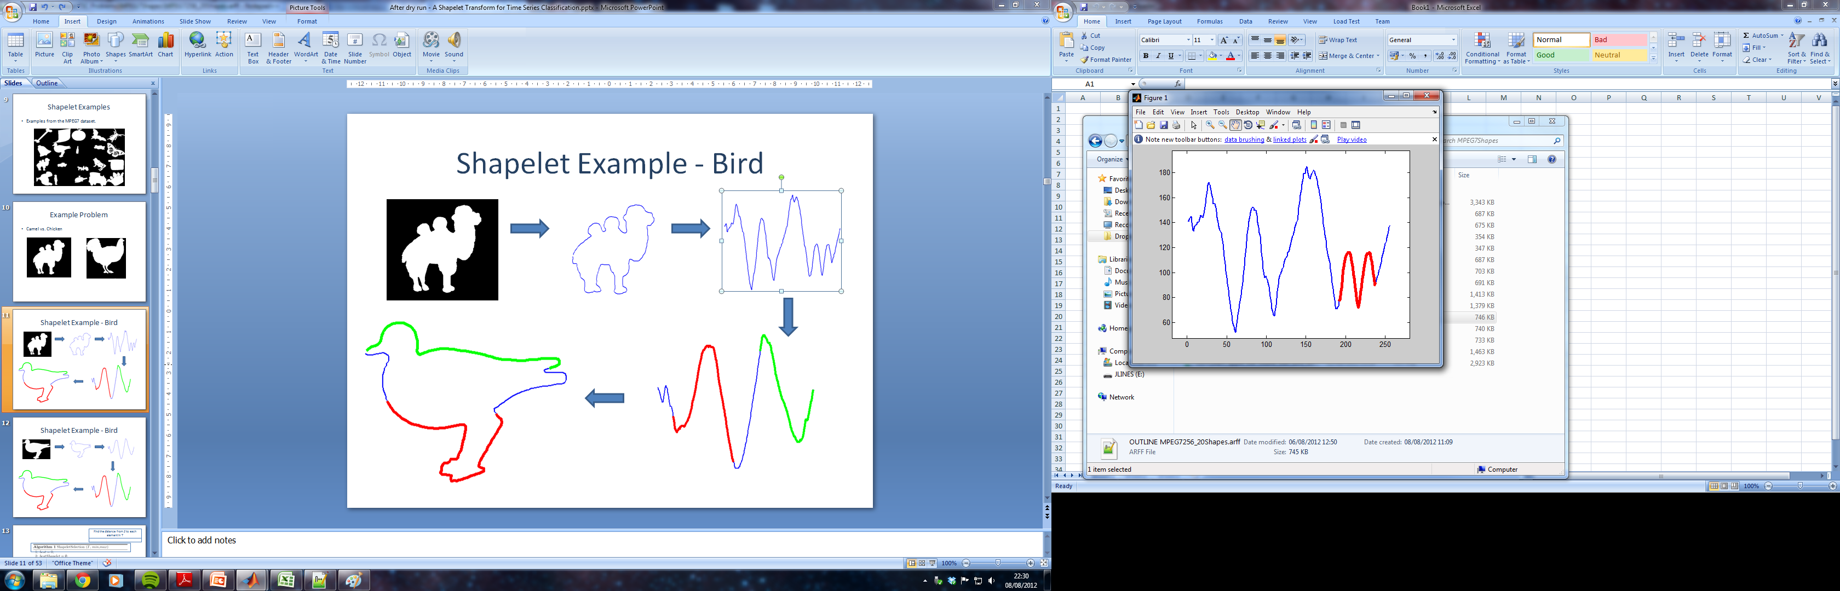

Shapelet-based Algorithms
Shapelets are discriminatory phase independent subseries
Camel or Chicken?
Shapelets are taken from the training data

Slide 21
Shapelet-based Algorithms
Shapelets are extracted from series, and the distance to a time series is used to determine how well a shapelet matches.
Good Match
OK Match
Bad Match

Slide 22
Shapelet Distance
The distance between a subsequence S of length l and a time series T_{i} is the minimum distance between S and all normalised subsequences of T_{i} of length l
0 | 3 | 9 | 14 | 1 | 2 | 7 | 1 | 2 | 1 | 15 | 2 | 10
1. Slide shapelet along T
-5 | 0 | 5
2. Normalise subseries
0 | 3 | 9
-1.07 | -0.267 | 1.336
3 | 9 | 14
3. Measure Euclidean distance to normalised shapelet
9 | 14 | 1
-1 | 0 | 1
14 | 1 | 2
= 0.435
1 | 2 | 7
4. Record lowest distance so far slide along
sDist = min(currentMin, 0.435)

Slide 23
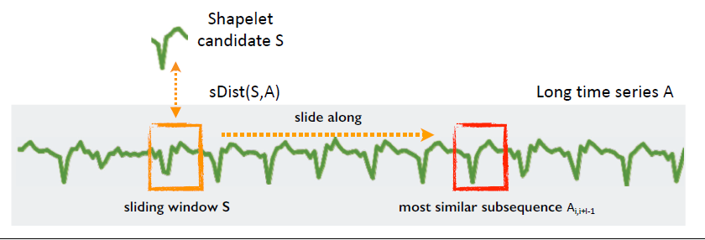
Shapelet Transform
The shapelet transform converts input time series to a feature vector using the distance to a collection of selected shapelets.
This feature vector is then used to build a regular estimator i.e. Rotation Forest or a linear classifier/regressor
 | S1 | S2 | S3 | S4
A1 | 0.024 | 5.124 | 7.682 | 0.715
A2 | 0.567 | 1.234 | 4.667 | 0.001
A3 | 4.567 | 6.231 | 12.435 | 4.456
A4 | 2.33 | 0.184 | 3.111 | 5.232
Lines, J., Davis, L.M., Hills, J. and Bagnall, A., 2012, August. A shapelet transform for time series classification. In Proceedings of the 18th ACM SIGKDD international conference on Knowledge discovery and data mining (pp. 289-297).
Bostrom, A. and Bagnall, A., 2015. Binary shapelet transform for multiclass time series classification. In Big Data Analytics and Knowledge Discovery: 17th International Conference, DaWaK 2015, Valencia, Spain, September 1-4, 2015, Proceedings 17 (pp. 257-269). Springer International Publishing.

Slide 24
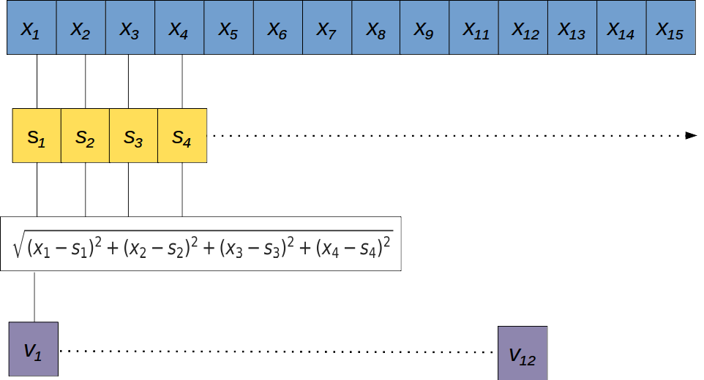
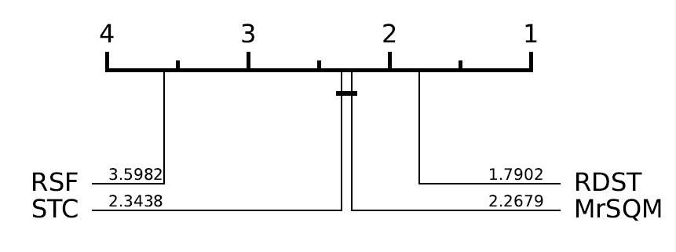
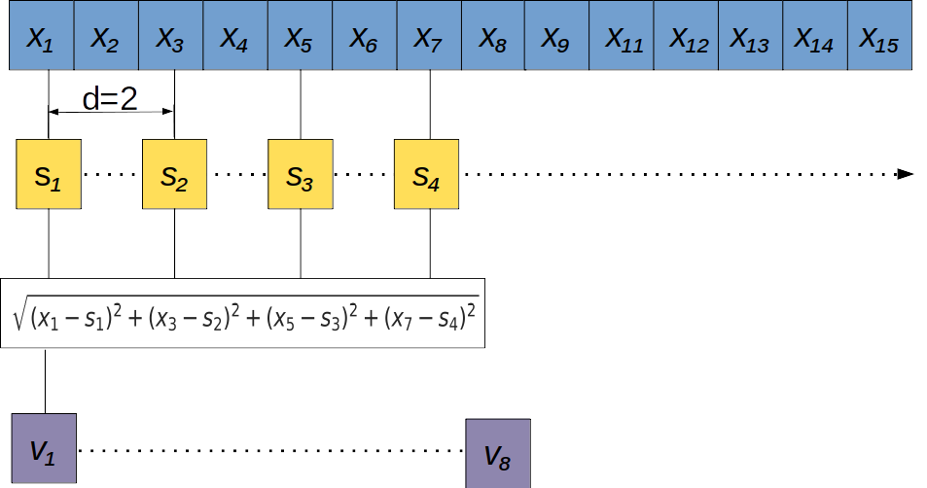
Dilated Shapelets
Shapelet algorithms have also improved over time, with concepts such as dilation from convolution based approaches being applied with success.
Guillaume, A., Vrain, C. and Elloumi, W., 2022, June. Random dilated shapelet transform: A new approach for time series shapelets. In International Conference on Pattern Recognition and Artificial Intelligence (pp. 653-664). Cham: Springer International Publishing.

Slide 25
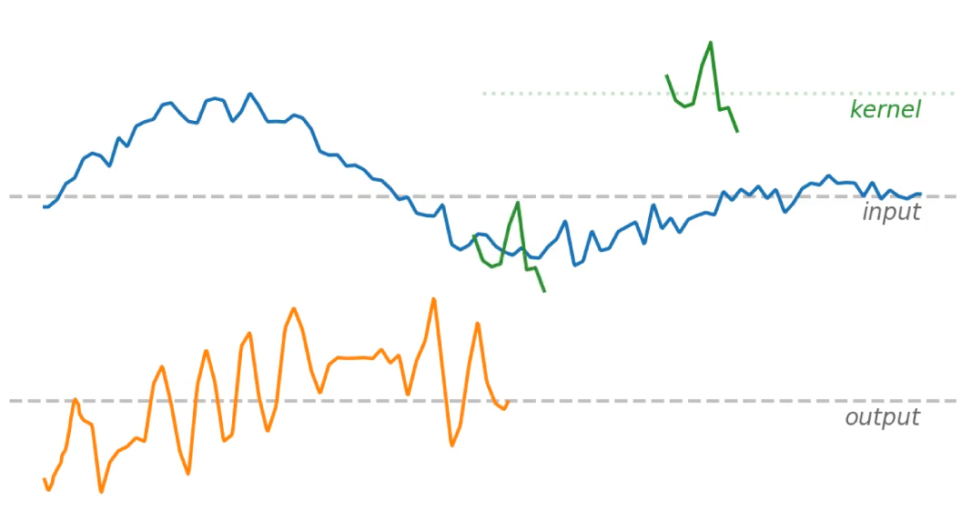
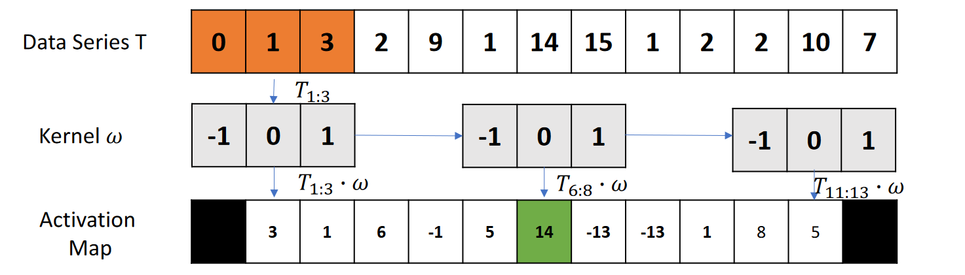
Convolution-based Algorithms
Convolution approaches used convolutional kernels with pooling operations to generate feature vectors.
These kernels are usually random, not learnt. Not deep learning!
Related to shapelets running a sliding window over the full series and pooling. Key difference is that shapelets use subseries extracted from the training data and distances.

Slide 26
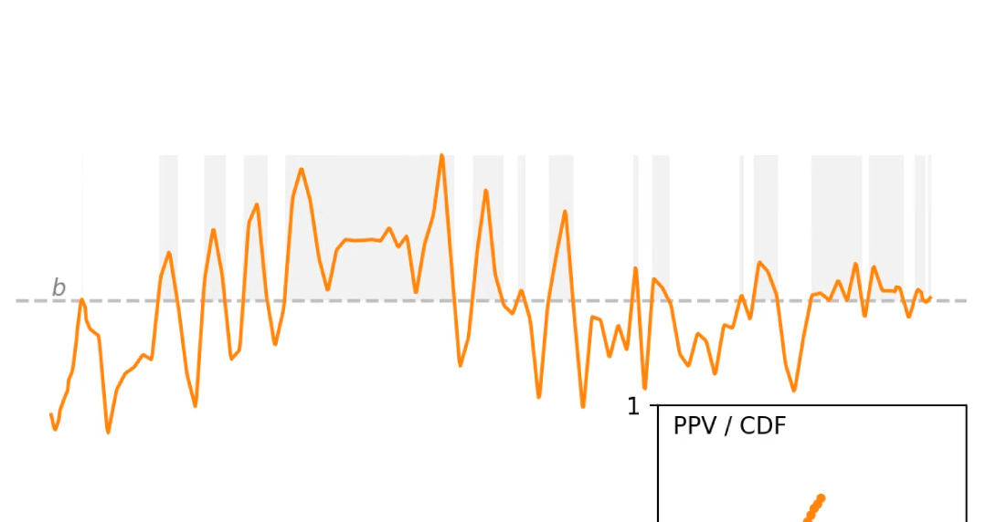
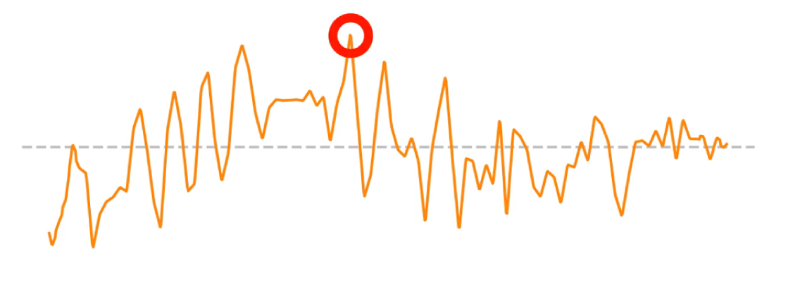
Convolution-based Algorithms
Features are extracted from the kernel output series using pooling operations i.e. the ROCKET classifier uses:
Max
Proportion of Positive Values (PPV)

Slide 27

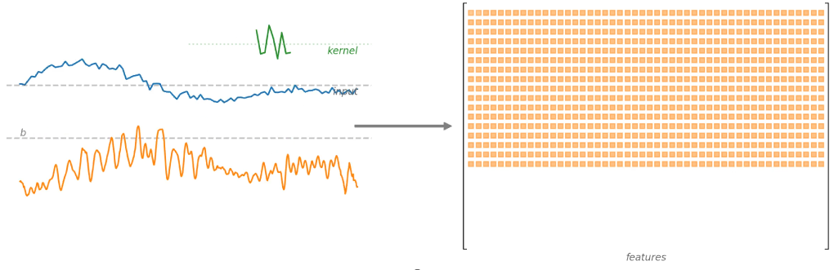
ROCKET
The ROCKET classifier applies thousands of randomly generated kernels (length, weights, bias, dilation, and padding) and builds a linear classifier with the pooled output.
}
linear classifier
Dempster, A., Petitjean, F. and Webb, G.I., 2020. ROCKET: exceptionally fast and accurate time series classification using random convolutional kernels. Data Mining and Knowledge Discovery, 34(5), pp.1454-1495.

Slide 28

ROCKET Variants
MiniRocket
MultiRocket
Random → fixed kernels
10,000 → 84 kernels (per dilation)
PPV only
Highly optimised (much faster than Rocket)
MiniRocket plus additional pooling operators (plus 1st order differences)
Rocket and MiniRocket “miss”: the magnitude of the response, the location of the response, the most prominent single response
MultiRocket uses PPV plus:
MPV: mean of positive values
MIPV: mean indices of positive values
LSPV: longest stretch of positive values
Similar speed to MiniRocket, significantly more accurate (on average)
Dempster, A., Schmidt, D.F. and Webb, G.I., 2021, August. Minirocket: A very fast (almost) deterministic transform for time series classification. In Proceedings of the 27th ACM SIGKDD conference on knowledge discovery & data mining (pp. 248-257).
Tan, C.W., Dempster, A., Bergmeir, C. and Webb, G.I., 2022. MultiRocket: multiple pooling operators and transformations for fast and effective time series classification. Data Mining and Knowledge Discovery, 36(5), pp.1623-1646.

Slide 29
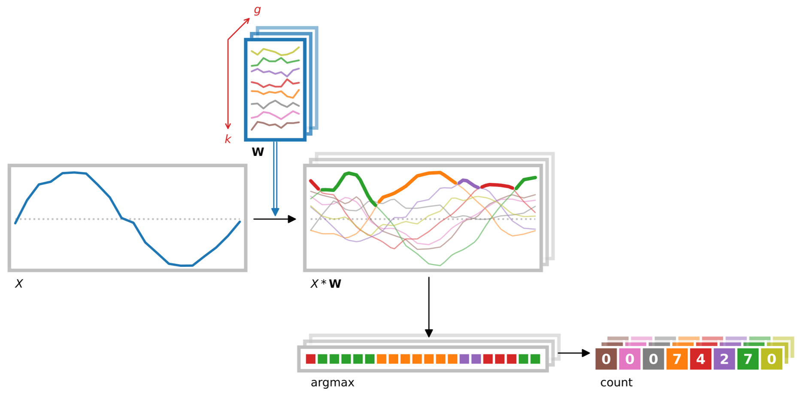
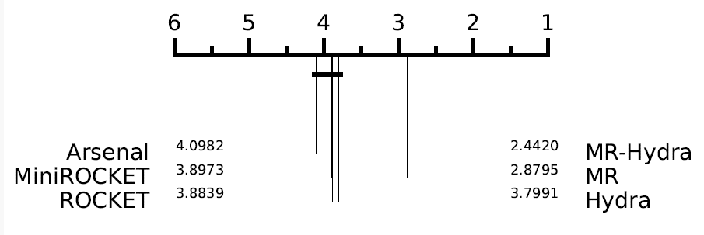
ROCKET Variants
Hydra
Combine Rocket + dictionary methods
Dictionary methods: count symbolic patterns
Hydra: count random patterns (represented by random convolutional kernels)
Organise kernels into “groups”
Count the kernel in each group with the max output at each timepoint
I.e., “competing” convolutional kernels
Combine with MultiRocket (“MultiRocket+Hydra”)
Dempster, A., Schmidt, D.F. and Webb, G.I., 2023. Hydra: Competing convolutional kernels for fast and accurate time series classification. Data Mining and Knowledge Discovery, 37(5), pp.1779-1805.

Slide 30
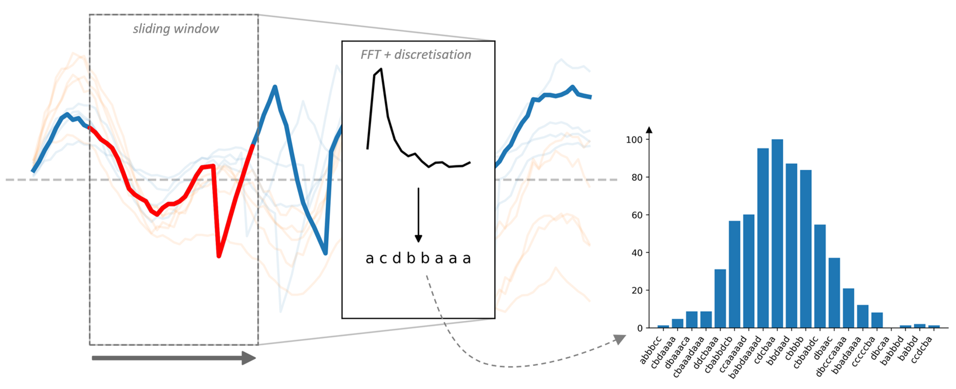
Dictionary-based Algorithms
Dictionary methods use the bag-of-words model commonly found in areas such as computer vision.
While shapelets look for the presence of a pattern, dictionary methods look for pattern repetition.

Slide 31
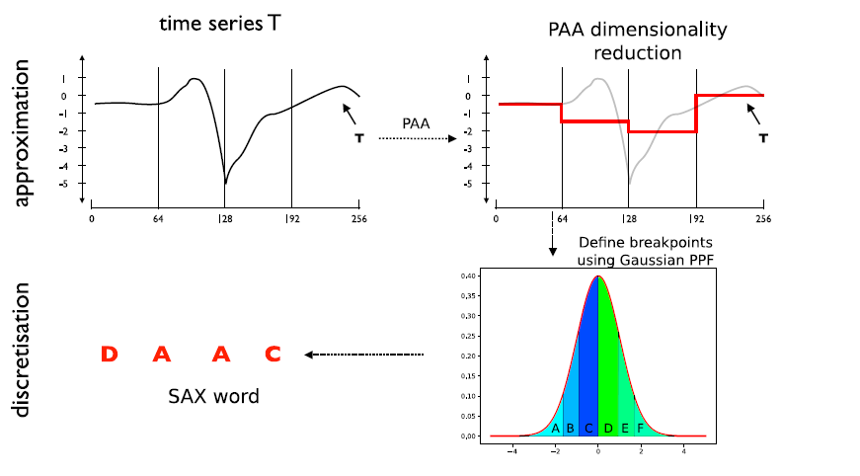
SAX Transform
Lin, J., Keogh, E., Wei, L. and Lonardi, S., 2007. Experiencing SAX: a novel symbolic representation of time series. Data Mining and knowledge discovery, 15, pp.107-144.

Slide 32
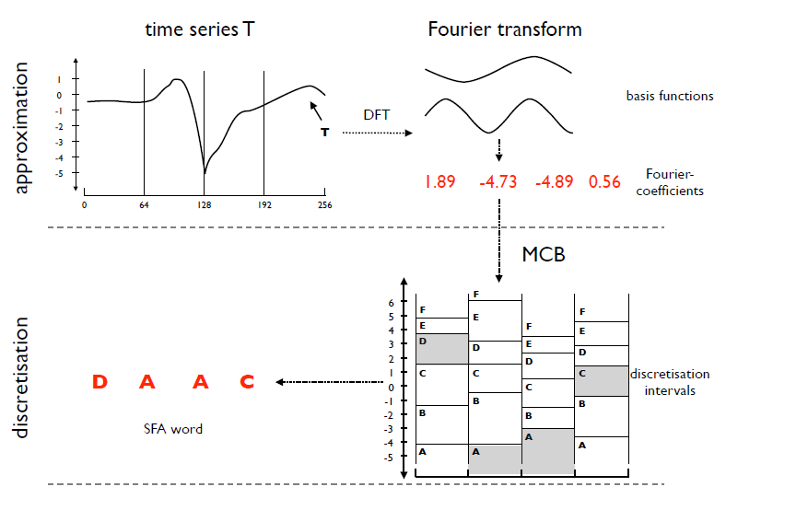
SFA Transform
Schäfer, P. and Högqvist, M., 2012, March. SFA: a symbolic fourier approximation and index for similarity search in high dimensional datasets. In Proceedings of the 15th international conference on extending database technology (pp. 516-527).

Slide 33
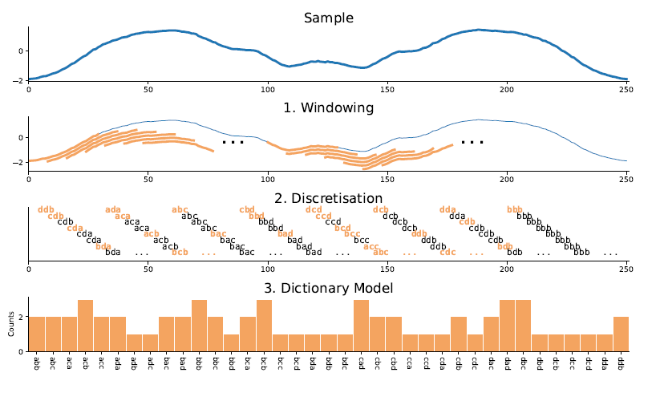
Bag of SFA Symbols
BOSS form an ensemble of 1NN classifiers using parameterised SFA transforms.
Performance of individual models can be sensitive to the word length and size of the sliding window, so poorly performing estimators are filtered out.
Schäfer, P., 2015. The BOSS is concerned with time series classification in the presence of noise. Data Mining and Knowledge Discovery, 29, pp.1505-1530.

Slide 34
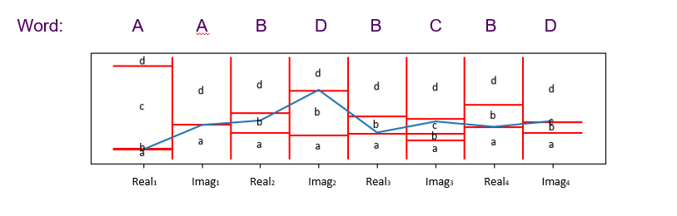
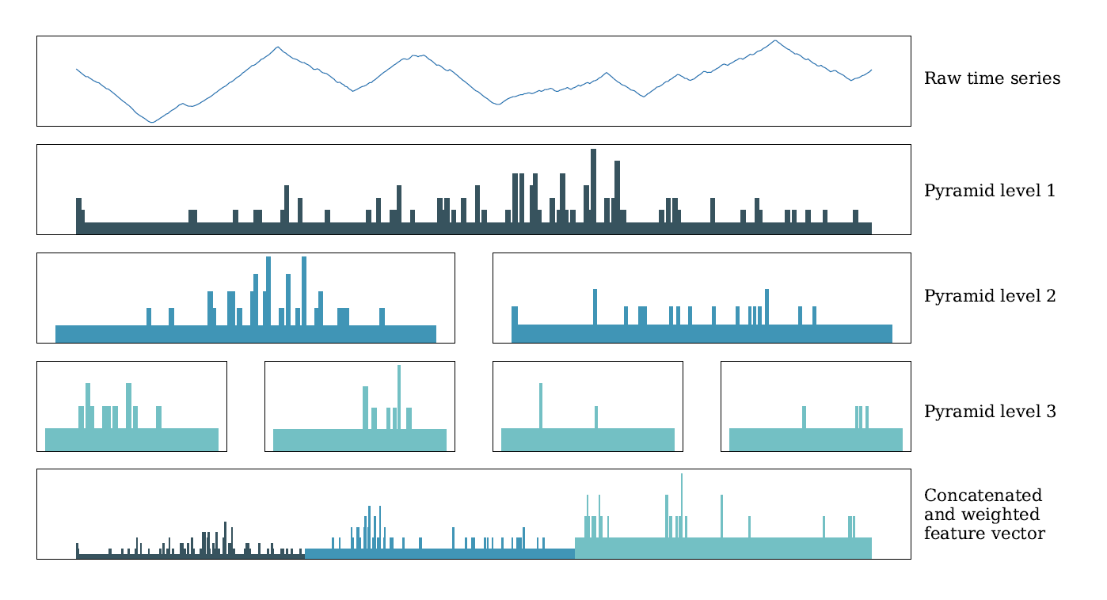

BOSS Extensions
WEASEL drops the ensemble format in favour of feature selection. Introduces dilation and supervised binning among other improvements.
TDE improves on the ensemble format and uses techniques such as spatial pyramids inspired from computer vision.
Schäfer, P. and Leser, U., 2023. WEASEL 2.0: a random dilated dictionary transform for fast, accurate and memory constrained time series classification. Machine Learning, 112(12), pp.4763-4788.
Middlehurst, M., Large, J., Cawley, G. and Bagnall, A., 2021. The temporal dictionary ensemble (TDE) classifier for time series classification. In Machine Learning and Knowledge Discovery in Databases: European Conference, ECML PKDD 2020, Ghent, Belgium, September 14–18, 2020, Proceedings, Part I (pp. 660-676). Springer International Publishing.

Slide 35

Deep Learning for TSC/TSER
Deep learning for time series is very large, but deep learning has its own section later in the tutorial!
Dedicated DL TSC page: https://msd-irimas.github.io/pages/dl4tsc/

Slide 36

Inception Time
InceptionTime is one of the more successful deep learning architectures for TSC.
One of its extensions, H-InceptionTime is one of the most accurate approaches in our latest comparison.
Ismail Fawaz, H., Lucas, B., Forestier, G., Pelletier, C., Schmidt, D.F., Weber, J., Webb, G.I., Idoumghar, L., Muller, P.A. and Petitjean, F., 2020. Inceptiontime: Finding alexnet for time series classification. Data Mining and Knowledge Discovery, 34(6), pp.1936-1962.

Slide 37


Hybrid Algorithms
Most of the approaches so far look for specific features in time series. But what if we don’t know what we are looking for?
Flat-COTE: Winner of first bake off
While accurate for the time, a few issues presented itself:
Very slow: full shapelet enumeration and distance based
Unstructured: more EE classifiers, greater weight in the ensemble.
Bagnall, A., Lines, J., Hills, J. and Bostrom, A., 2015. Time-series classification with COTE: the collective of transformation-based ensembles. IEEE Transactions on Knowledge and Data Engineering, 27(9), pp.2522-2535.

Slide 38

HIVE-COTE
Building on the success, HIVE-COTE forms a meta-ensemble of the original bakeoff approaches, adding BOSS and TSF as well as condensing the distance, shapelet and spectral approaches into single models.
Lines, J., Taylor, S. and Bagnall, A., 2016, December. Hive-cote: The hierarchical vote collective of transformation-based ensembles for time series classification. In 2016 IEEE 16th international conference on data mining (ICDM) (pp. 1041-1046). IEEE.

Slide 39

HIVE-COTE 2.0
Introduced a new classifiers
TDE
Arsenal
DrCIF
Dropped spectral classifier (frequency domain embedded in other classifiers)
Improved methods for estimating accuracy from the train set
Removed distance based Elastic Ensemble (slow)
Uses a randomised shapelet transform (faster)
Middlehurst, M., Large, J., Flynn, M., Lines, J., Bostrom, A. and Bagnall, A., 2021. HIVE-COTE 2.0: a new meta ensemble for time series classification. Machine Learning, 110(11), pp.3211-3243.

Slide 40


Classification Comparison
HC2 on average >12% more accurate than 1NN-DTW (SOTA in 2014)
HC2 much slower than MR-H
Don’t discount the other algorithms, there is no one model to rule them all
Middlehurst, M., Schäfer, P. and Bagnall, A., 2024. Bake off redux: a review and experimental evaluation of recent time series classification algorithms. Data Mining and Knowledge Discovery, pp.1-74.
Dau, H.A., Bagnall, A., Kamgar, K., Yeh, C.C.M., Zhu, Y., Gharghabi, S., Ratanamahatana, C.A. and Keogh, E., 2019. The UCR time series archive. IEEE/CAA Journal of Automatica Sinica, 6(6), pp.1293-1305.

Slide 41

Regression Comparison
Interest in extrinsic regression (TSER) is research much more recent than TSC.
DrCIF regressor the only algorithm from our comparison better than a standard regressor
InceptionTime has high variance, sometimes failing spectacularly (good overall rank, very bad average MSE)
Others TSC algorithms may need regression specific adaptation
Tan, C.W., Bergmeir, C., Petitjean, F. and Webb, G.I., 2021. Time series extrinsic regression: Predicting numeric values from time series data. Data Mining and Knowledge Discovery, 35(3), pp.1032-1060.
Guijo-Rubio, D., Middlehurst, M., Arcencio, G., Silva, D.F. and Bagnall, A., 2024. Unsupervised feature based algorithms for time series extrinsic regression. Data Mining and Knowledge Discovery, pp.1-45.

Slide 42
Thanks for listening! Next up: Clustering
For aeon example code see: part2_classification_regression.ipynb
If you are interested in more, see the resources our KDD tutorial:
A Hands-on Introduction to Time Series Classification and Regression
A Hands-on Introduction to Time Series Classification and Regression
https://aeon-tutorials.github.io/KDD-2024/

